Slide 1
Milestone Presentation (1)
Exploration with a single Agent
02.12.2021

Slide 2
Overview
Working Progress, Team name
Demo Code + Visuals
Difficulties
Next steps

Slide 3
Working Progress
Getting an agent to move
Getting all agents to move (random)
Getting agents to see tasks
Implementing a way to get close enough
Accepting Tasks
Thinking of a team name

Slide 4
Most Important part: Team name
TotallyNotSpies (TNS)
Cause they´re agents xD

Slide 5
Code
Live-Demo
Git:
https://github.com/DieMango/PiB_Bri_Och/

Slide 6
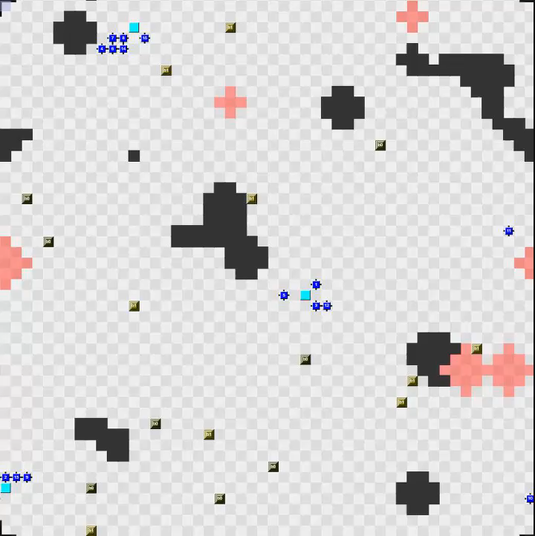
Visuals
Video

Slide 7
Difficulties
A lot of trial and error
Getting used to the working progress and software
Seemingly random errors (eg socket problem)
…

Slide 8
Next Steps (1)
Implementing a more efficient movement
Getting the agents to leave the task block after getting a task
Question: can only the agent who accepted the task cmplete said task?
More efficient pathing towards tasks
(eg avoiding obstacles like other agents/ enviroment)

Slide 9
Next Steps (2) Milestone 3
Submitting single-block tasks
Grabbing (needed) blocks with an agent
Finding and reaching goal-zones
Storing positions of important entities

